Slide 1
Supplier Data Analysis
Michael Boshra
Hassan Mohamed
Youssef Ayman
Vivian Magdy

Slide 2

Project idea: The Supplier Data Analysis Project aims to streamline and optimize supplier relationships by analyzing data related to pricing, product offerings, and marketing strategies. The project focuses on identifying inefficiencies, discrepancies, and opportunities for improvement in supplier pricing and marketing efforts. By leveraging data analytics, the project provides actionable insights to ensure more competitive pricing, accurate supplier information, and better-targeted marketing strategies.

Slide 3

Pricing Issues: Inconsistent Supplier Pricing: Identified significant variations in pricing across different suppliers for the same product. Pricing Discrepancies: Detected pricing inconsistencies due to outdated or incorrect data in the system. Unclear Pricing Models: Lack of transparency in supplier pricing structures leading to overpayment in some cases.

Slide 4

Marketing Issues: Inaccurate Supplier Information: Incorrect or incomplete marketing information leading to reduced visibility and misrepresentation of supplier offerings. Lack of Competitive Benchmarking: No analysis on how supplier pricing compared to competitors, making it difficult to optimize marketing strategies. Misaligned Target Audience: Supplier marketing efforts not aligned with the right customer segments, reducing conversion rates.

Slide 5

Solutions:
Standardized Pricing Model: Implemented a uniform pricing model across suppliers to ensure consistency.
Enhanced Supplier Information: Updated supplier profiles with accurate data to reflect true offerings, improving marketing accuracy.
Competitive Pricing Analysis: Conducted benchmarking to align supplier pricing with market rates, boosting competitiveness.
Targeted Marketing Strategy: Developed a data-driven marketing plan that better aligned with the target customer base.

Slide 6
The programs used:
Python
POWER BI
SQL

Slide 7
Description of the Database Architecture Type:
Relational Database Management System: Structure Data is organized into tables with rows and columns. Each table represents a specific entity and includes relationships defined by foreign keys.

Slide 8
Key Entities:
Table1: Customers - include CustomerID, FirstName, LastName, City ,Country, Phone
Table2: Products - include ProductID, ProductName, Category, UnitPrice, UnitCost, Package, IsDiscontinued
Table3: Orders - include OrderID&Date, Month , OrderNumber ,CustomerID, TotalAmount.
Table4: OrderItem - include OrderDetailID, OrderID, ProductID, UnitPrice, Quantity.
Table5: Supplier - SupplierID, CompanyName, ContactName, ContactTitle, City , Country , Phone, Fax.

Slide 9
Relationships
Customers orders One-to-Many (one customer can have multiple orders)
Orders to Order Item: One-to-Many (one order can contain multiple items).
Product to Order Item: One-to-Many (one product can appear in multiple orders).
Supplier to Product: One- to-Many (one Supplier is linked to multiple Product).

Slide 10
Data Flow: Data Collection
1-Source: Data is initially collected in an Excel file, where multiple tables (5 tables) are organized into separate sheets.
2-Methods of Collection: Data import from other databases and external form data sources.
3. Data Storage CSV Conversion :Python scripts are used to read the Excel file and convert each table into a separate CSV file .
Database Import :
The CSV files are imported into a relational database (SQL).
1-Creating tables in the database that match the structure of the CSV files.
2-Using SQL commands to load the CSV data into the tables
Data Access-SQL Queries:
1-Data is accessed through SQL queries, allowing users to perform operations like selecting, filtering, joining tables, and aggregating data.
2-Relationships between tables enable complex queries to retrieve related data across multiple entities.
3.Visualization with Power BI : The SQL database is connected to Power BI for reporting and visualization. This allows users to create dashboards, charts, and graphs to analyze the data dynamically.

Slide 11
Data Visualization
Introduction: Why We Chose Power BI
We chose Power BI for this project because it offers powerful data visualization and reporting capabilities while allowing us to integrate and connect directly with SQL databases. By using Power BI, we could easily transform our cleaned and structured data into interactive dashboards. After using Python for data cleaning and SQL for data modeling, Power BI helped us ensure that the data relationships were accurately transferred before we focused on visualizing the insights.

Slide 12
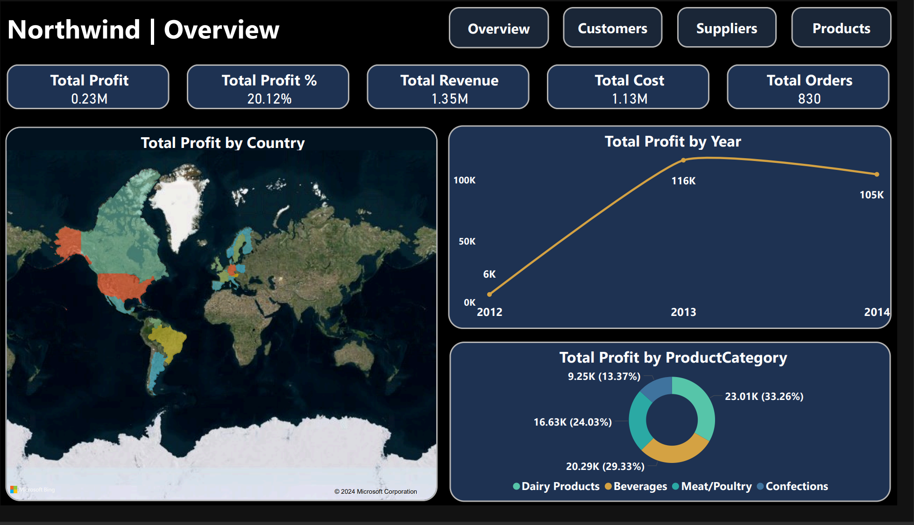
Our overview Dashboard

Slide 13
Report

Slide 14
Team Members And Roles
Data Cleaning by Python (Hassan,Vivian)
SQL(Michael,Youssef)
Dashboard(Michael)

Slide 15
Thanks

